Slide 1


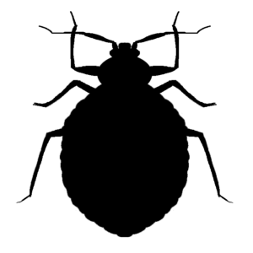

K Q H S
L i c e n s e d P C O
L L C
Moisture Detection
WDO Inspection Reporting
Opossum
Quality Food Safety Consulting
Termite Control
Allow The Kaptain
To Provide You With
Around The Helm
Pest Protection
Synthetic Products
Natural & Organic Products
Drain Assessment/Clean Out
Thermal Imagery
Trapping & Removal
Preventative
Skunk
Bed Bugs
Roaches
Rodent Control
OMRI Products
15% Discount For Vets, Elderly & Disabled
Quick Knock Down
Exclusion
Maintenance
Insured
J i m m i e K i l g o r e J r
O w n e r / O p e r a t o r
T e r m i t e a n d P e s t C o n t r o l
W e b – w w w . K Q H S L L C . c o m
M o b i l e – 6 1 6 – 4 2 7 - 0 7 5 2
Bee & Wasp Control
Ants
Sanitation Consulting

